Slide 1


WICKED ADVENTURES
Guided by:
Dr. Paul Greaney
Presented by:
Anup Jacob (L00163455)
Muhammed Shafeeq Thottathil
Sreejith Jayasree Purushothaman
Snehal Khairnar
Snehal Sudhakar Shirsath
Varnit Rohilla
DEVOPS PROJECT MANAGEMENT TEAM ASSIGNMENT
APRIL 2022

Slide 2
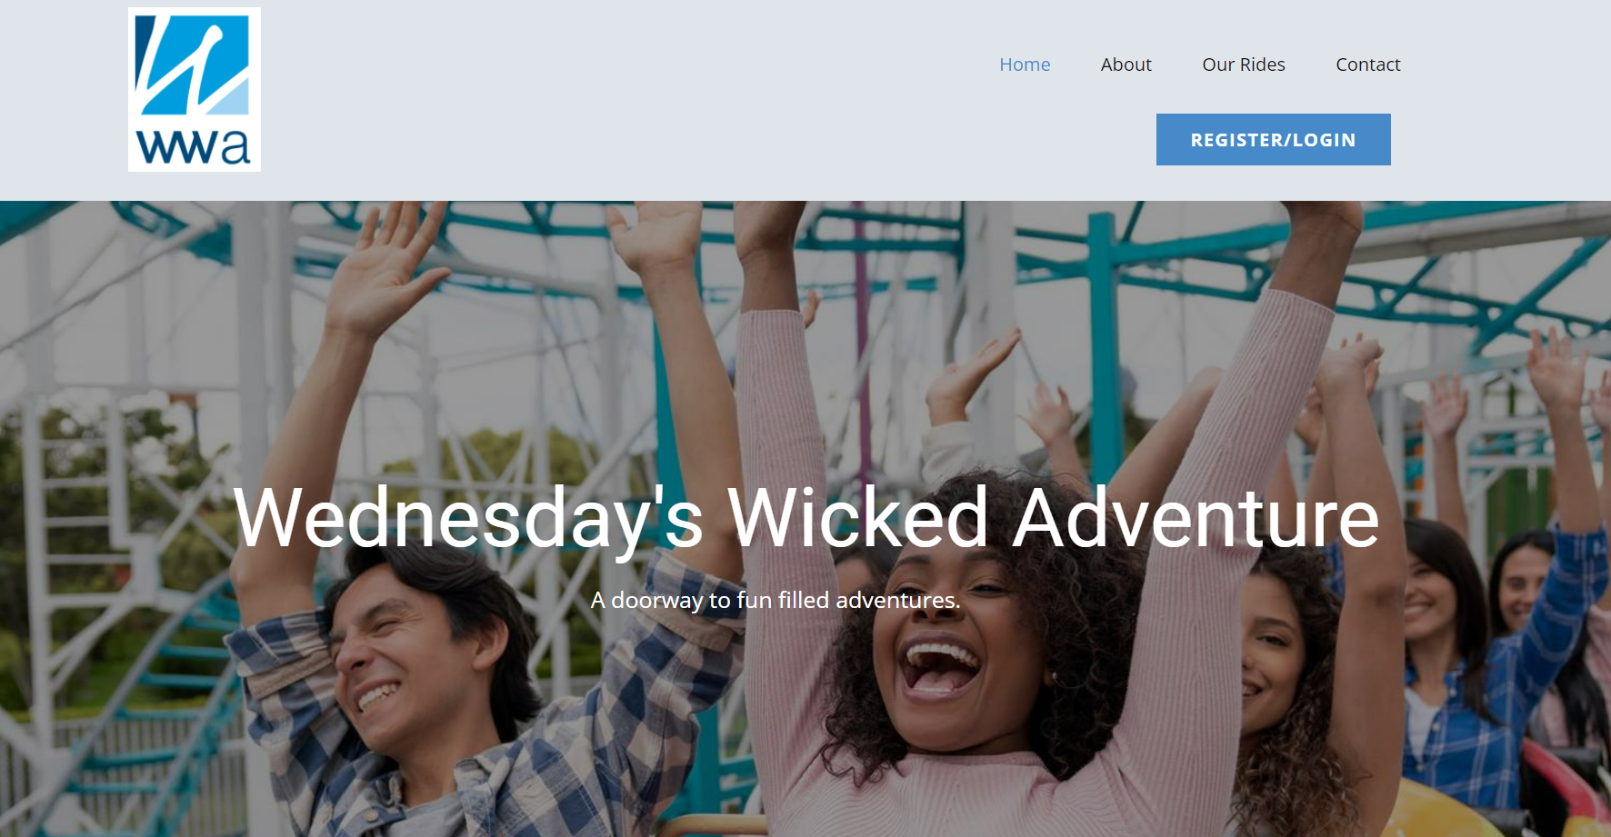
INTRODUCTION
Web Application for Project – Wednesday’s Wicked Adventures.
Online booking system for an adventure theme park.
Customers needs to register and signup for booking.
Web application created in DevOps workflow.
WEDNESDAY’S WICKED ADVENTURES
APRIL 2022

Slide 3
APPLICATION
WEDNESDAY’S WICKED ADVENTURES
APRIL 2022

Slide 4

Flask web framework
HTML – Standard Mark up Language used for creating web documents.
CSS – Describes the presentation properties of the web document written in HTML format. Includes Layouts, fonts, colors, etc.
Website builder tool partly used for easy webpage creation with better design, looks and functionality - nicepages.
Development and testing for each page implemented before integrating with python.
Static IP address used for accessing the HTML webpages run via app.py.
Issues found during testing were added to JIRA.
WEDNESDAY’S WICKED ADVENTURES
APRIL 2022

Slide 5
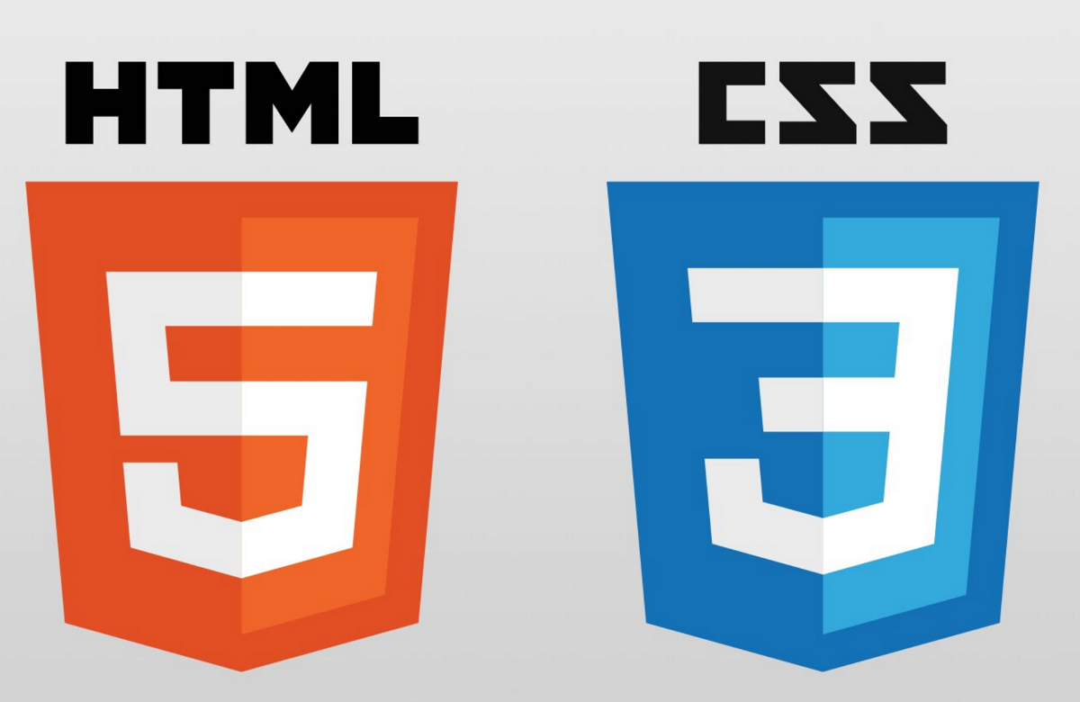
HTML and CSS
HTML – Standard Mark up Language used for creating web documents.
CSS – Describes the presentation properties of the web document written in HTML format. Includes Layouts, fonts, colors, etc.
Website builder tool partly used for easy webpage creation with better design, looks and functionality - nicepages.
Development and testing for each page implemented before integrating with python.
Static IP address used for accessing the HTML webpages run via app.py.
Issues found during testing were added to JIRA.
WEDNESDAY’S WICKED ADVENTURES
APRIL 2022

Slide 6

DATABASE
Database used – MySQL.
Initial development and testing done in Local DB.
Database used to store the customer data and connect the Front-end (HTML) for access.
Third party tools used to develop and run the queries including SQL workbench.
Pre-requisites – Installation of MySQL Server.
Higher environment testing done in free and open-source MySQL hosting website configured by : https://www.freemysqlhosting.net.
WEDNESDAY’S WICKED ADVENTURES
APRIL 2022

Slide 7
GitHub for Repository
GitHub - Provider of Internet hosting for software development and version control using Git.
GitHub repository link for the project :
https://github.com/devopslecturer/awmsc2022.git.
Build, deployments and other tools are integrated into GitHub using “GitHub Actions” functionality.
YAML Files created and added to the ‘.github/workflows’ inside the repository.
WEDNESDAY’S WICKED ADVENTURES
APRIL 2022

Slide 8
TOOLS USED IN GITHUB ACTIONS
Docker.
Jmeter.
Pytest for Unit testing.
Snyk for security.
AWS EKSs
Sphinx for Autodocumentation.
WEDNESDAY’S WICKED ADVENTURES
APRIL 2022

Slide 9

Docker
Docker is an open-source project that automates the deployment of applications inside software containers.
Docker automates creation of lightweight - Application container
Container will virtually run anywhere.
Dockerfile: A text document that contains all the commands to assemble an image.
DockerImage: It is used to execute code in a Docker container.
Container: A portable executable package which includes applications and their dependencies. It is the runnable instance of an image.
WEDNESDAY’S WICKED ADVENTURES
APRIL 2022

Slide 10
Docker
Why Docker:
Gives us a Rapid Deployment
Its configuration is Simple and Faster
Provides a security for application deployment
CI Efficiency is plus point
Why not other tools:
Less portable containers in LXC container,
No kubernetes integration is available in OpenVZ
require the Mesos framework to run the container in Mesos containerizer
WEDNESDAY’S WICKED ADVENTURES
APRIL 2022

Slide 11
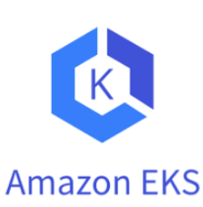
AWS EKS
Amazon Elastic Kubernetes Service (Amazon EKS) is a managed container service to run and scale Kubernetes applications in the cloud or on-premises.
Create applications that automatically scale up and down and run in a highly available configuration across multiple Availability Zones (AZs) with out-of-the-box networking and security integrations.
Why AWS EKS:
advantage of the performance, scale, reliability, and availability of AWS infrastructure. ..continued
WEDNESDAY’S WICKED ADVENTURES
APRIL 2022

Slide 12
AWS EKS
2. Integrations with AWS networking and security services, such as application load balancers (ALBs) for load distribution
3. Amazon EKS lets you create, update, scale, and terminate nodes for your cluster with a single command.
Why not other tools:
GKE will only match the EKS 99.95% SLA if you use Regional Clusters, which costs $0.10 per cluster per hour which is costlier than EKS
Only one zonal cluster is free in GKE
The network policies need to enabled when creating the cluster and cannot be enabled on an existing cluster in AKS
WEDNESDAY’S WICKED ADVENTURES
APRIL 2022

Slide 13
ytest for unit testingest for unit testingor unit testing
2. PYTEST – UNIT TESTING
PyTest is a testing framework that allows users to write test scripts in Python.
It helps with the development of tests ranging from simple unit tests to large functional tests.
Pytest is very easy, open source and run the test in parallel manner.
Unit testing has been performed using PyTest.
Integration of PyTest in GitHub action using python application.
Details provided in the Git Wiki link in our repository. Click here.
WEDNESDAY’S WICKED ADVENTURES
APRIL 2022

Slide 14

5. SPHINX TOOL - AUTO DOCUMENTATION
An Open-source third party Tool used for auto documentation.
A documentation generator written in python language.
Implementation of Sphinx tool by creating YAML file using “GitHub Actions”.
Themes available in the URL below :
https://www.sphinx-doc.org/en/master/usage/theming.html
Details provided in the Git Wiki link in our repository. Click here.
Branch created for auto documentation – ‘gh-pages’ (Default).
WEDNESDAY’S WICKED ADVENTURES
APRIL 2022

Slide 15
GIT WIKI - USER GUIDES & INSTRUCTIONS
Platform provided by Git for adding documentation for the projects hosted in the GitHub repository.
Users can add and edit wiki pages directly on GitHub or locally using the command line.
GitHub repository for our project can be accessed using the link below.
URL: https://github.com/devopslecturer/awmsc2022/wiki
WEDNESDAY’S WICKED ADVENTURES
APRIL 2022

Slide 16
4. CONCLUSION
WEDNESDAY’S WICKED ADVENTURES
APRIL 2022

Slide 17

WEDNESDAY’S WICKED ADVENTURES
APRIL 2022

Slide 18

WEDNESDAY’S WICKED ADVENTURES
APRIL 2022

